Slide 1
LECTURE 11 :
Closing the loop – Optimization and generative algorithms
Self driving labs algorithmics
Pascal Miéville Stefano di Leone Edy Mariano Jean-Charles Cousty
Notes:
1

Slide 2
01
02
03
The different groups of algorithms in an automated lab
Closing the loop
Self-driving lab
Notes:
2

Slide 3
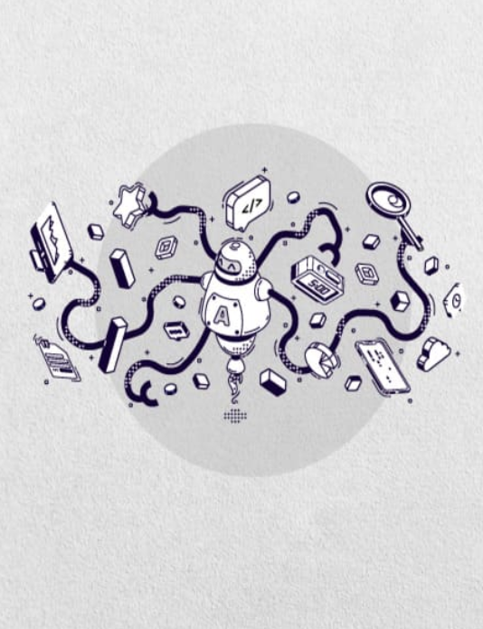
1. The different groups of algorithms in an automated lab
Notes:
3

Slide 4
1. The different groups of algorithms in an automated lab
Definition and precision
A finite set of unambiguous instructions that, given some set of initial conditions, can be performed in a prescribed sequence to achieve a certain goal and that has a recognizable set of end conditions.
The American Heritage® Dictionary of the English Language, 5th Edition
Algorithms can be or not based on AI/ML/DL strategies. We will consider the two categories.
Notes:
Picture 1 : Arduino → https://www.hiclipart.com/free-transparent-background-png-clipart-siglg
Picture 3 : Stepper Motor → https://www.hiclipart.com/free-transparent-background-png-clipart-xcntx
Picture 4 : Gripper HandE → https://robotiq.com/fr/produits/main-adaptative-a-2-doigts-hand-e
Picture 5 : Sick Sensor https://www.sick.com/ch/fr/capteurs-photoelectriques/capteurs-photoelectriques/w9/c/g186889

Slide 5
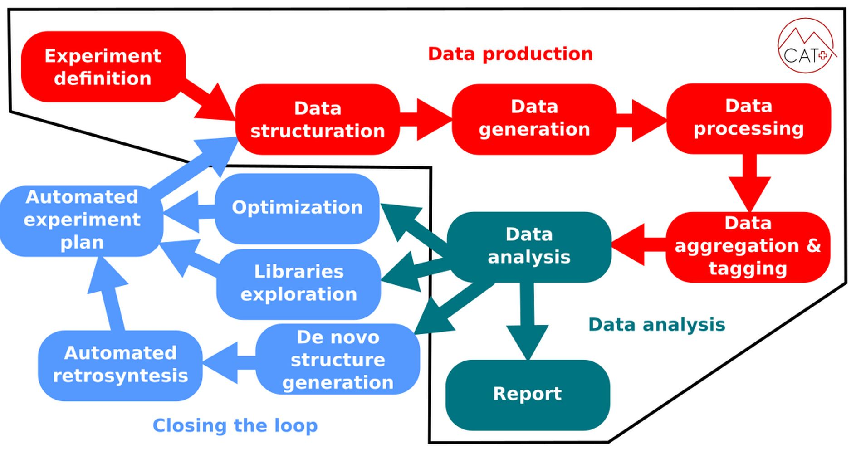
1. The different groups of algorithms in an automated lab

Slide 6
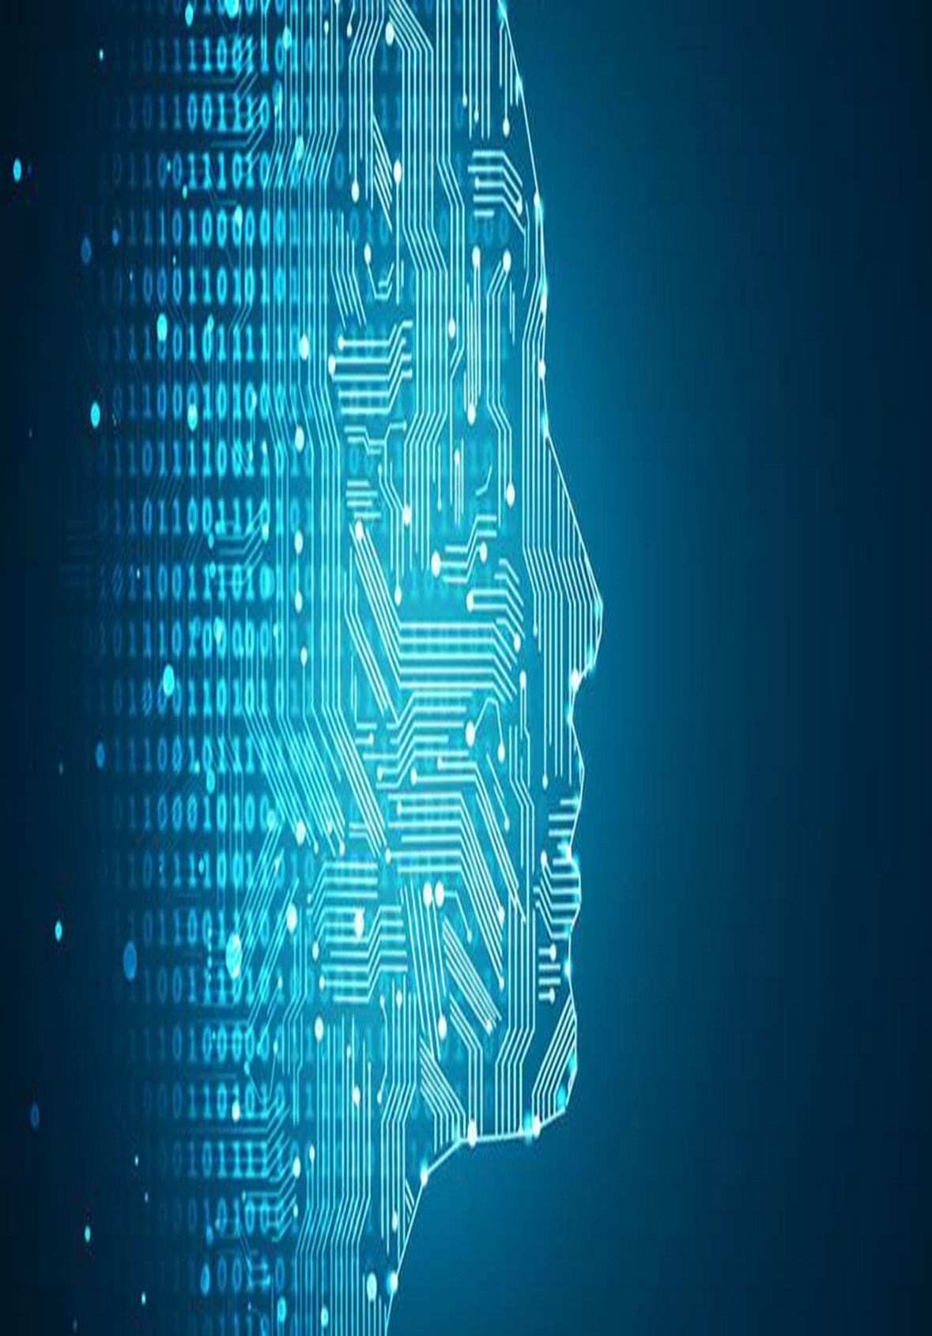
2. Algorithms in an automated laboratory
Notes:
6

Slide 7
2. Algorithms in an automated laboratory
Notes:
Picture 1 : Arduino → https://www.hiclipart.com/free-transparent-background-png-clipart-siglg
Picture 3 : Stepper Motor → https://www.hiclipart.com/free-transparent-background-png-clipart-xcntx
Picture 4 : Gripper HandE → https://robotiq.com/fr/produits/main-adaptative-a-2-doigts-hand-e
Picture 5 : Sick Sensor https://www.sick.com/ch/fr/capteurs-photoelectriques/capteurs-photoelectriques/w9/c/g186889

Slide 8
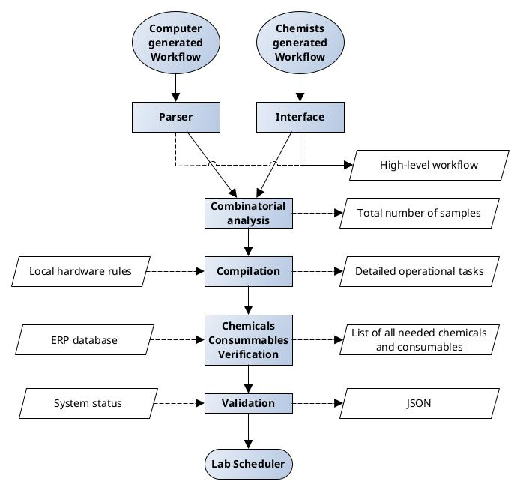
2. Algorithms in an automated laboratory
Experiment definition/encoding - HCI
Notes:
Picture 1 : Arduino → https://www.hiclipart.com/free-transparent-background-png-clipart-siglg
Picture 3 : Stepper Motor → https://www.hiclipart.com/free-transparent-background-png-clipart-xcntx
Picture 4 : Gripper HandE → https://robotiq.com/fr/produits/main-adaptative-a-2-doigts-hand-e
Picture 5 : Sick Sensor https://www.sick.com/ch/fr/capteurs-photoelectriques/capteurs-photoelectriques/w9/c/g186889

Slide 9
2. Algorithms in an automated laboratory
Experiment definition/encoding - HCI
The chemist makes "educated" guesses about
reaction outcomes
molecular solubility
best analytical methods
or goes blind and test all analytical methods and multiple solutions
loss of solvent
loss of time
loss of material
Computer (remote) generated workflows are literature based and necessarily general
not designed for specific hardware setup
not informed of sample prep and analytical methods
Notes:
Picture 1 : Arduino → https://www.hiclipart.com/free-transparent-background-png-clipart-siglg
Picture 3 : Stepper Motor → https://www.hiclipart.com/free-transparent-background-png-clipart-xcntx
Picture 4 : Gripper HandE → https://robotiq.com/fr/produits/main-adaptative-a-2-doigts-hand-e
Picture 5 : Sick Sensor https://www.sick.com/ch/fr/capteurs-photoelectriques/capteurs-photoelectriques/w9/c/g186889

Slide 10
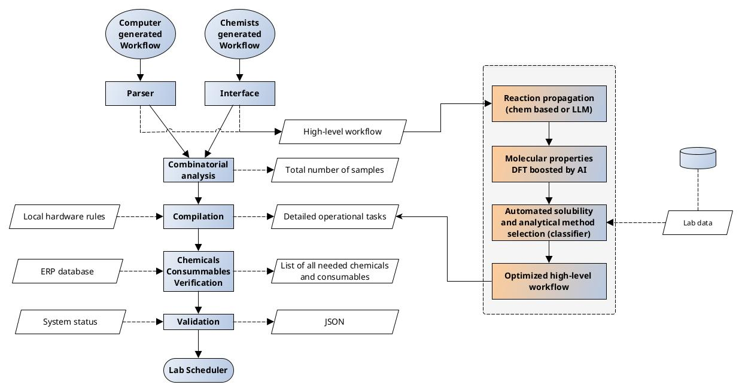
2. Algorithms in an automated laboratory
Experiment definition/encoding - HCI - optimized algorithmic
B. A. Grzybowski et al., Computer-Assisted Synthetic Planning, 2016, 10.1002/anie.201506101 (Chemistry rules based)
Merck Synthia™ Organic Retrosynthesis Software
P. Schwaller et al., ChemCrow: Augmenting large-language models with chemistry tools. 2023, 10.48550/arXiv.2304.05376
(LLM based)
Zheng, P., Zubatyuk, R., Wu, W. et al. Artificial intelligence-enhanced quantum chemical method with broad applicability, 2021, 10.1038/s41467-021-27340-2
Notes:
Picture 1 : Arduino → https://www.hiclipart.com/free-transparent-background-png-clipart-siglg
Picture 3 : Stepper Motor → https://www.hiclipart.com/free-transparent-background-png-clipart-xcntx
Picture 4 : Gripper HandE → https://robotiq.com/fr/produits/main-adaptative-a-2-doigts-hand-e
Picture 5 : Sick Sensor https://www.sick.com/ch/fr/capteurs-photoelectriques/capteurs-photoelectriques/w9/c/g186889

Slide 11
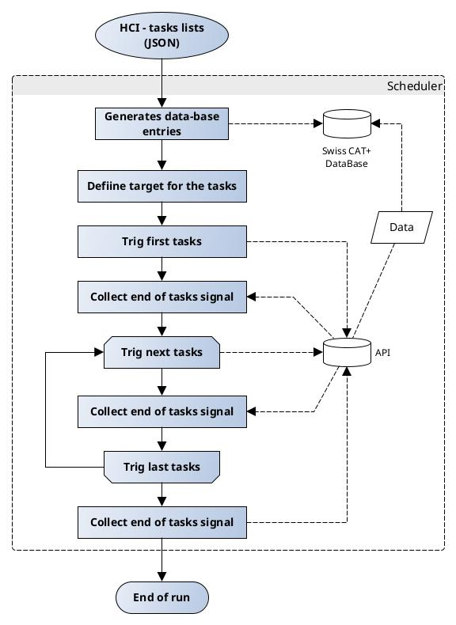
2. Algorithms in an automated laboratory
Lab scheduling / orchestration
Notes:
Picture 1 : Arduino → https://www.hiclipart.com/free-transparent-background-png-clipart-siglg
Picture 3 : Stepper Motor → https://www.hiclipart.com/free-transparent-background-png-clipart-xcntx
Picture 4 : Gripper HandE → https://robotiq.com/fr/produits/main-adaptative-a-2-doigts-hand-e
Picture 5 : Sick Sensor https://www.sick.com/ch/fr/capteurs-photoelectriques/capteurs-photoelectriques/w9/c/g186889

Slide 12
2. Algorithms in an automated laboratory
Lab scheduling / orchestration
Static scheduling approach :
fixed time operations
fixed workflows
not optimized w.r.t real exp. duration
Notes:
Picture 1 : Arduino → https://www.hiclipart.com/free-transparent-background-png-clipart-siglg
Picture 3 : Stepper Motor → https://www.hiclipart.com/free-transparent-background-png-clipart-xcntx
Picture 4 : Gripper HandE → https://robotiq.com/fr/produits/main-adaptative-a-2-doigts-hand-e
Picture 5 : Sick Sensor https://www.sick.com/ch/fr/capteurs-photoelectriques/capteurs-photoelectriques/w9/c/g186889

Slide 13
2. Algorithms in an automated laboratory
Lab scheduling / orchestration potential developments
Optimize tasks distribution
1. Collect offline operational information
2. Generate optimized tasks attribution rules
3. Compile the new rules with the tasks lists received from HCI
Dynamic scheduling
1. Collect online operational information, e.g. : signal intensity or specific value (IR, NMR, pH-meter,...)
2. Define a rule
3. Stop the tasks as soon as the rule is activated
BoFire - Bayesian Optimization Framework Intended for Real Experiments (https://github.com/experimental-design/bofire)
Notes:
Picture 1 : Arduino → https://www.hiclipart.com/free-transparent-background-png-clipart-siglg
Picture 3 : Stepper Motor → https://www.hiclipart.com/free-transparent-background-png-clipart-xcntx
Picture 4 : Gripper HandE → https://robotiq.com/fr/produits/main-adaptative-a-2-doigts-hand-e
Picture 5 : Sick Sensor https://www.sick.com/ch/fr/capteurs-photoelectriques/capteurs-photoelectriques/w9/c/g186889

Slide 14
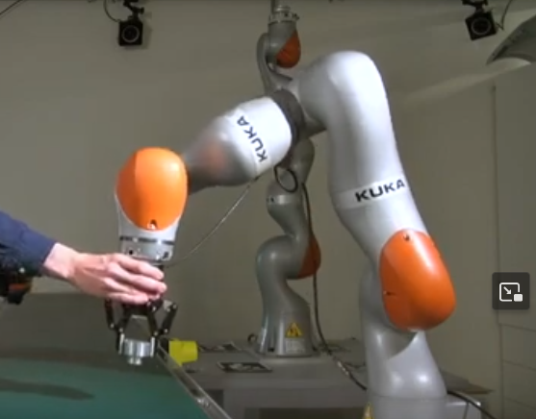
2. Algorithms in an automated laboratory
Lab scheduling / orchestration potential developments
Dynamic sample selection for full characterization
1. Automatically process screening results (LC-DAD-MS)
2. Check DB status
3. Define best samples to analyze
Quality optimized
Concentration optimized
4. Generates new entries in the HCI for the selected samples
Optimize robotic functions
Optimized 6-axis arms with AI and vision for complex operations such as solid sampling (e.g. aica.tech)
Agilent processing tools, MestreLab MGear, SwissCAT+ developments
Notes:
Picture 1 : Arduino → https://www.hiclipart.com/free-transparent-background-png-clipart-siglg
Picture 3 : Stepper Motor → https://www.hiclipart.com/free-transparent-background-png-clipart-xcntx
Picture 4 : Gripper HandE → https://robotiq.com/fr/produits/main-adaptative-a-2-doigts-hand-e
Picture 5 : Sick Sensor https://www.sick.com/ch/fr/capteurs-photoelectriques/capteurs-photoelectriques/w9/c/g186889

Slide 15




2. Algorithms in an automated laboratory
Data processing / elucidation
Integrated baseline correction
Integrated phase correction
Peak fittings
Peak data extractions
Notes:
Picture 1 : Arduino → https://www.hiclipart.com/free-transparent-background-png-clipart-siglg
Picture 3 : Stepper Motor → https://www.hiclipart.com/free-transparent-background-png-clipart-xcntx
Picture 4 : Gripper HandE → https://robotiq.com/fr/produits/main-adaptative-a-2-doigts-hand-e
Picture 5 : Sick Sensor https://www.sick.com/ch/fr/capteurs-photoelectriques/capteurs-photoelectriques/w9/c/g186889

Slide 16
2. Algorithms in an automated laboratory
Data processing / elucidation
Proprietary formats
Potentially hidden processing
zero filling
appodization
filters
Automated baseline correction
Automated phase correction
Peak fittings
Peak data extractions
Quality control
extract and report error on fits
baseline correction
deconvolution
Notes:
Picture 1 : Arduino → https://www.hiclipart.com/free-transparent-background-png-clipart-siglg
Picture 3 : Stepper Motor → https://www.hiclipart.com/free-transparent-background-png-clipart-xcntx
Picture 4 : Gripper HandE → https://robotiq.com/fr/produits/main-adaptative-a-2-doigts-hand-e
Picture 5 : Sick Sensor https://www.sick.com/ch/fr/capteurs-photoelectriques/capteurs-photoelectriques/w9/c/g186889

Slide 17
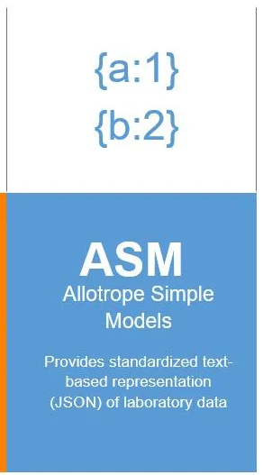



2. Algorithms in an automated laboratory
Data processing / elucidation
Non proprietary data format with generic processing and elucidation algorithms
1. Process ASM and JDX files with open-sourced algorithms
2. Extract peak lists, peak properties
3. Elucidate potential structures using open-sourced algorithms
(chem based and/or DL based)
4. Calculate properties for the potential structures (pKa, LogP....) with AI boosted DFT and black box tools
5. Compile these information with their respective uncertainty in the data ontology
JCAMP-DX (files)
XY values
See section 3 for more details on data processing
Notes:
Picture 1 : Arduino → https://www.hiclipart.com/free-transparent-background-png-clipart-siglg
Picture 3 : Stepper Motor → https://www.hiclipart.com/free-transparent-background-png-clipart-xcntx
Picture 4 : Gripper HandE → https://robotiq.com/fr/produits/main-adaptative-a-2-doigts-hand-e
Picture 5 : Sick Sensor https://www.sick.com/ch/fr/capteurs-photoelectriques/capteurs-photoelectriques/w9/c/g186889

Slide 18
2. Algorithms in an automated laboratory
Generative algorithms
Closing the loop
high-level workflows
Bayesian Optimization for conditions
e.g. BOFIRE
Chemical space explorations
(libraries or de novo)
e.g. Chem. Sci., 2020, 10.1039/D0SC00554A
Automated retrosynthesis
e.g. ChemCrow
Automated protocol
generators
e.g. Science Advances, 2023, 10.1126/sciadv.adj0461
...
See next lecture 12 for more information about these generative algorithms
Notes:
Picture 1 : Arduino → https://www.hiclipart.com/free-transparent-background-png-clipart-siglg
Picture 3 : Stepper Motor → https://www.hiclipart.com/free-transparent-background-png-clipart-xcntx
Picture 4 : Gripper HandE → https://robotiq.com/fr/produits/main-adaptative-a-2-doigts-hand-e
Picture 5 : Sick Sensor https://www.sick.com/ch/fr/capteurs-photoelectriques/capteurs-photoelectriques/w9/c/g186889

Slide 19
2. Algorithms in an automated laboratory
Take home message
3 different families of algorithms in an automated lab :
1. Dedicated to molecular optimization (de novo, library exploration, BO for reaction conditions,...)
2. Dedicated to method optimization (solubility, separation, ...)
3. Dedicated to lab operation optimization (scheduling, robot competencies,...)
They are all necessary to make real the idea of an entirely automated synthetic laboratory.
It is interesting to combine AI/ML/DL approaches with different pre-existing tools (e.g. DFT).
Notes:
Picture 1 : Arduino → https://www.hiclipart.com/free-transparent-background-png-clipart-siglg
Picture 3 : Stepper Motor → https://www.hiclipart.com/free-transparent-background-png-clipart-xcntx
Picture 4 : Gripper HandE → https://robotiq.com/fr/produits/main-adaptative-a-2-doigts-hand-e
Picture 5 : Sick Sensor https://www.sick.com/ch/fr/capteurs-photoelectriques/capteurs-photoelectriques/w9/c/g186889

Slide 20
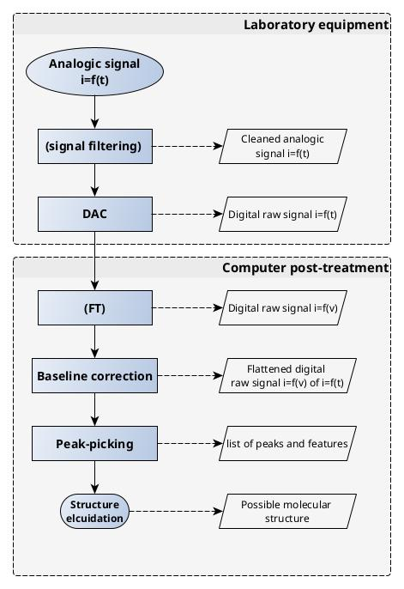
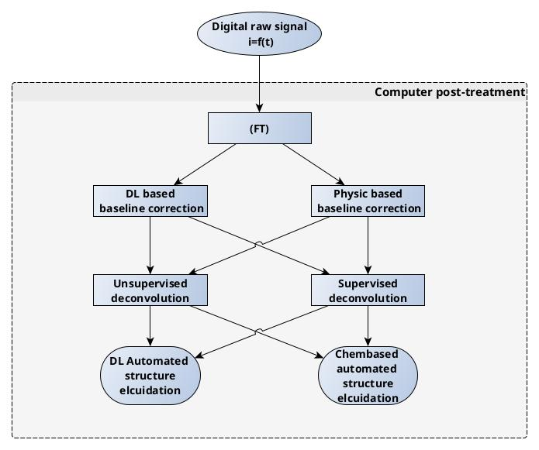
3. Data processing - new algorithms for processing and elucidation
Notes:
Picture 1 : Arduino → https://www.hiclipart.com/free-transparent-background-png-clipart-siglg
Picture 3 : Stepper Motor → https://www.hiclipart.com/free-transparent-background-png-clipart-xcntx
Picture 4 : Gripper HandE → https://robotiq.com/fr/produits/main-adaptative-a-2-doigts-hand-e
Picture 5 : Sick Sensor https://www.sick.com/ch/fr/capteurs-photoelectriques/capteurs-photoelectriques/w9/c/g186889

Slide 21
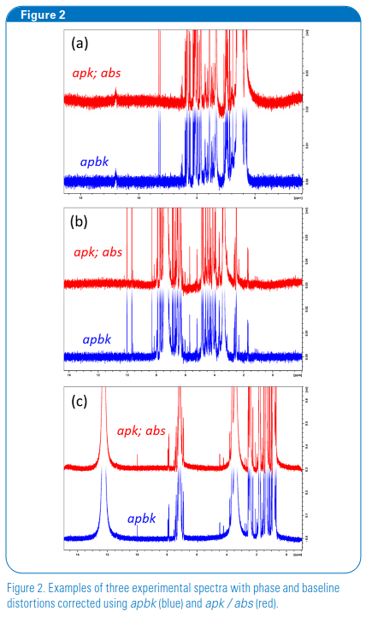
3. Data processing - new algorithms for processing and elucidation
Deep learning-based phase and baseline correction, of 1D 1H NMR Spectra, Simon Bruderer, Federico Paruzzo and Christine Bolliger, Bruker Switzerland AG, 8117 Fällanden, Switzerland.
Notes:
Picture 1 : Arduino → https://www.hiclipart.com/free-transparent-background-png-clipart-siglg
Picture 3 : Stepper Motor → https://www.hiclipart.com/free-transparent-background-png-clipart-xcntx
Picture 4 : Gripper HandE → https://robotiq.com/fr/produits/main-adaptative-a-2-doigts-hand-e
Picture 5 : Sick Sensor https://www.sick.com/ch/fr/capteurs-photoelectriques/capteurs-photoelectriques/w9/c/g186889

Slide 22
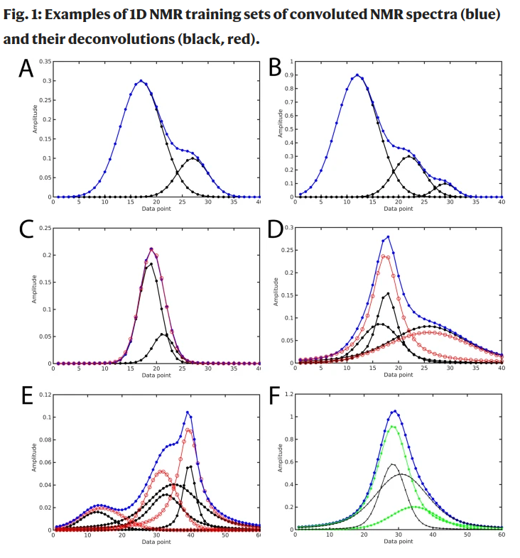
3. Data processing - new algorithms for processing and elucidation
Li, DW., Hansen, A.L., Yuan, C. et al. DEEP picker is a deep neural network for accurate deconvolution of complex two-dimensional NMR spectra. Nat Commun 12, 5229 (2021). https://doi.org/10.1038/s41467-021-25496-5
Notes:
Picture 1 : Arduino → https://www.hiclipart.com/free-transparent-background-png-clipart-siglg
Picture 3 : Stepper Motor → https://www.hiclipart.com/free-transparent-background-png-clipart-xcntx
Picture 4 : Gripper HandE → https://robotiq.com/fr/produits/main-adaptative-a-2-doigts-hand-e
Picture 5 : Sick Sensor https://www.sick.com/ch/fr/capteurs-photoelectriques/capteurs-photoelectriques/w9/c/g186889

Slide 23
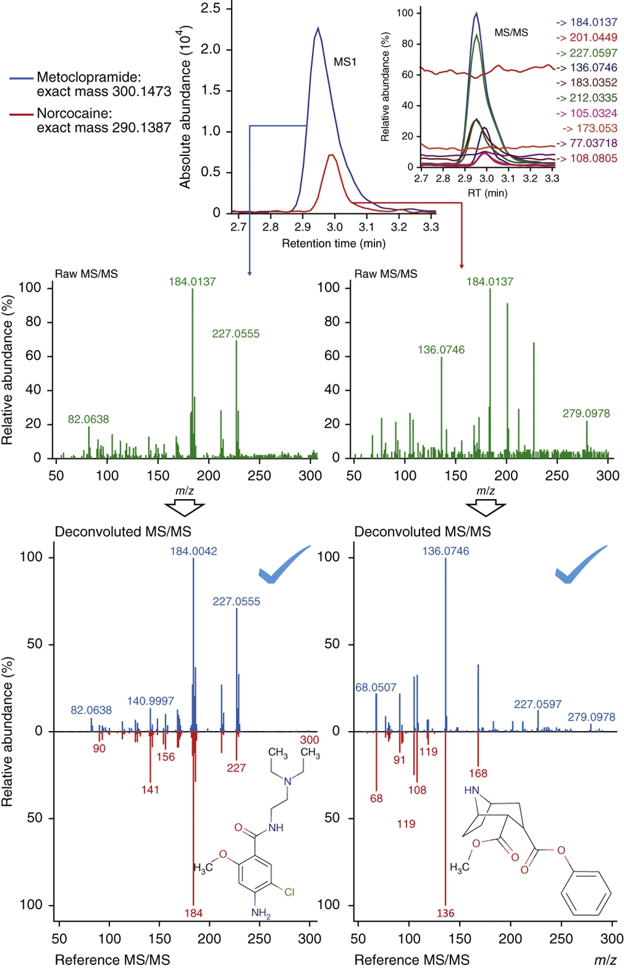
3. Data processing - new algorithms for processing and elucidation
Tsugawa, H., Cajka, T., Kind, T. et al. MS-DIAL: data-independent MS/MS deconvolution for comprehensive metabolome analysis. Nat Methods 12, 523–526 (2015). https://doi.org/10.1038/nmeth.3393
Notes:
Picture 1 : Arduino → https://www.hiclipart.com/free-transparent-background-png-clipart-siglg
Picture 3 : Stepper Motor → https://www.hiclipart.com/free-transparent-background-png-clipart-xcntx
Picture 4 : Gripper HandE → https://robotiq.com/fr/produits/main-adaptative-a-2-doigts-hand-e
Picture 5 : Sick Sensor https://www.sick.com/ch/fr/capteurs-photoelectriques/capteurs-photoelectriques/w9/c/g186889

Slide 24
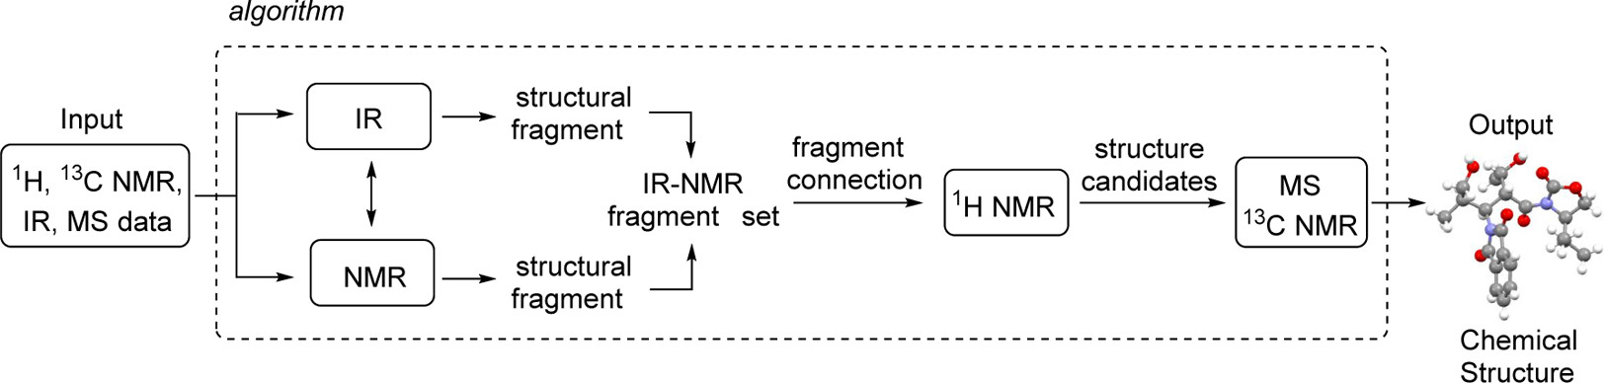
3. Data processing - structure elucidation
Matevž Pesek, Andraž Juvan et al. Automated Structure Elucidation of Organic Molecules Based on IR, 1H NMR, 13C NMR, and MS Data, J. Chem. Inf. Model. 2021, 61, 2, 756–763
Notes:
Picture 1 : Arduino → https://www.hiclipart.com/free-transparent-background-png-clipart-siglg
Picture 3 : Stepper Motor → https://www.hiclipart.com/free-transparent-background-png-clipart-xcntx
Picture 4 : Gripper HandE → https://robotiq.com/fr/produits/main-adaptative-a-2-doigts-hand-e
Picture 5 : Sick Sensor https://www.sick.com/ch/fr/capteurs-photoelectriques/capteurs-photoelectriques/w9/c/g186889

Slide 25
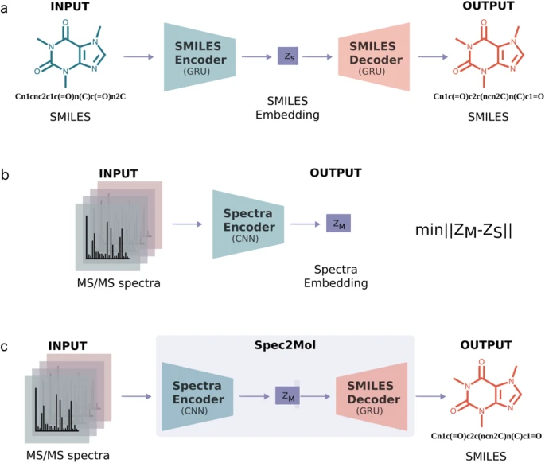
3. Data processing - structure elucidation
Litsa, E.E., Chenthamarakshan, V., Das, P. et al. An end-to-end deep learning framework for translating mass spectra to de-novo molecules. Commun Chem 6, 132 (2023). https://doi.org/10.1038/s42004-023-00932-3
Notes:
Picture 1 : Arduino → https://www.hiclipart.com/free-transparent-background-png-clipart-siglg
Picture 3 : Stepper Motor → https://www.hiclipart.com/free-transparent-background-png-clipart-xcntx
Picture 4 : Gripper HandE → https://robotiq.com/fr/produits/main-adaptative-a-2-doigts-hand-e
Picture 5 : Sick Sensor https://www.sick.com/ch/fr/capteurs-photoelectriques/capteurs-photoelectriques/w9/c/g186889

Slide 26





Next week
Thanks to
Swiss CAT+ team & partners
Chemistry generative algorithms
Dr Patrick Ruch
IBM Research Zurich
Notes:
26

